Slide 1
Engineering 3-2 Programs 3 years at one school 2 years at an engineering school Dual Degree in Physics and Engineering
At Stout you can do the same thing in five years without having to change schools
Notes:
What is your dream job? Where do you want to work?
How many of you know what kind of job you want when you graduate?
How many of you know you want to work outside of Wisconsin?
How many of you have friends and family here and absolutely want to stay in Wisconsin?
How are you going to make yourself stand out in the crowd of new engineers?
In 2015 there were 106,658 new bachelors degrees in engineering. About a quarter of those were mechanical engineers
. How are you going to stand out in a crowd?

Slide 2
Jobs for Bachelor’s Degrees in Physics (without engineering degree!)
Mechanical Engineer
Electrical Engineer
Optical Engineer
Laser Engineer
Systems Engineer
Process Engineer
Design Engineer
Software Engineer
Software Developer
Programmer
Analyst
And many more
Imagine what someone with a double-degree could accomplish!
Notes:
A sample of job titles from a 2015 survey of undergraduate physics majors after graduation
A physicist is someone who can use quantitative reasoning and create models to solve a variety of problems.
(without an engineering degree. Think what you could do with a physics degree AND an engineering degree!)
There are almost no jobs with the title “Physicist”
Physicists are generalists while engineers are specialists.
Related but different skill-set.

Slide 3
Physics at UW-Stout
PhyCEE
Double-Major in Physics and Computer/Electrical Engineering
Additional Courses:
Intro to Physics Research
Intro to Quantum Mechanics
Computational Classical Physics
Solid State Physics
Applied Optics and Photonics
Advanced Physics Lab
Quantum Mechanics
Contact Prof. Zimmerman for more information:
zimmermant@uwstout.edu
Lasers, Optics, Plasmas, Computational Modeling, and Quantum Computers

Slide 4
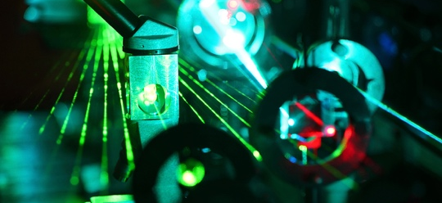
Physics Minor
Statics and Dynamics or University Physics I
University Physics II
11 credits from the following:
PHYS-139 Intro to Research
CEE-355 Applied E&M
Any PHYS-3XX
Thermodynamics (PHYS-222 or ENGR-275 or ME-390)
Classes in bold are ones you take for your major
so you only need 5 more credits for the minor
Contact Prof. Sinkovits for information: sinkovitsd@uwstout.edu
Also take a look at the Material Science minor and the new Semiconductor Manufacturing minor
Contact Dr. Patterson: pattersonm@uwstout.edu
Notes:
CEE-355 also counts

Slide 5
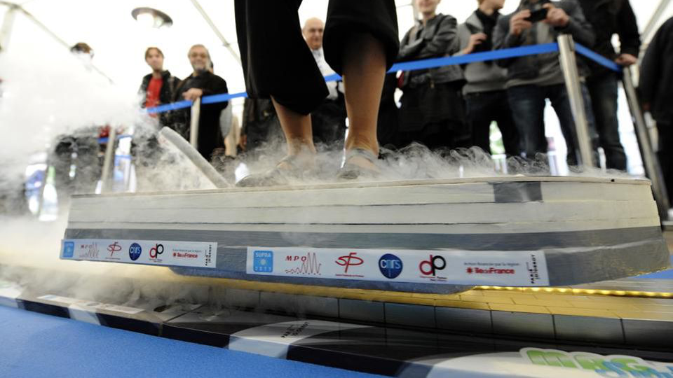
PHYS-427 (3 cr.)
Solid State and Condensed Matter Physics
Crystalline structure, lattice vibration
and energy states, Brillouin zones,
electrons in metals, energy bands and
gaps, diffraction.
Spring 2025, MWF 2:30 PM
pre-req: PHYS-282 University Physics II
Next offering: Spring 2027
pattersonm@uwstout.edu
Required in
B.S. in Physics
B.S. in Applied Science
Applied Physics (APP) concentration
Materials and Nanoscience (MNS) concentration
Elective for
Minors in: Materials Science, Physics, Semiconductor Manufacturing
Industrial Chemistry concentration of Applied Science
MagFly superconductor skate, a 'floating' universal magnet system by German B.T. Innovation Company that allows a hundred-kilo person to levitate. (Photo: BERTRAND GUAY/AFP/Getty Images)

